Slide 1
Lecture 18: Regulating Cars
Prof. Austin
Environmental Economics Econ 4075

Slide 2
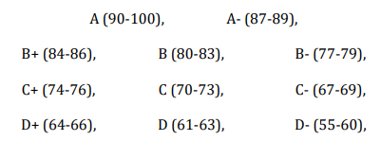
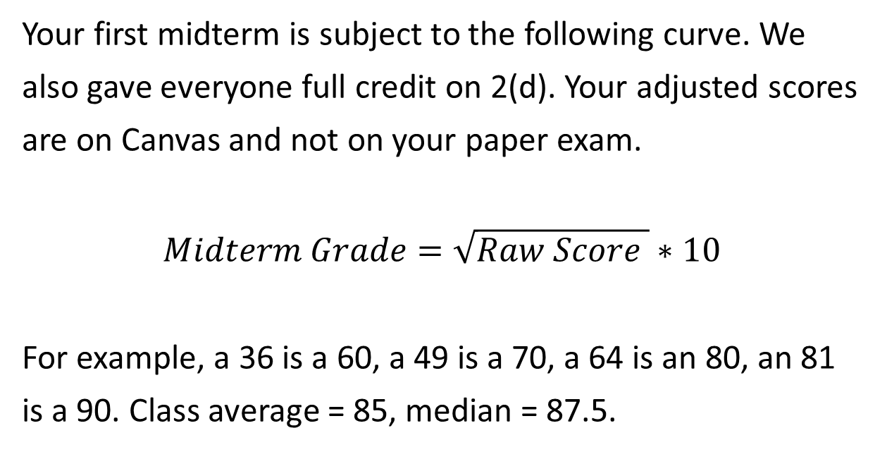
Midterm #1
Your first midterm is subject to the following curve. We also gave everyone full credit on 2(d). Your adjusted scores are on Canvas and not on your paper exam.
$$Midterm Grade=\sqrt{Raw Score }∗10$$
For example, a 36 is a 60, a 49 is a 70, a 64 is an 80, an 81 is a 90. Class average = 85, median = 87.5.
 | Raw Uncurved Range | Student Count
A | 76-100 | 19
B | 59-75 | 14
C | 45-59 | 5
D | 30-44 | 2
F | <30 | 0

Slide 3
Roadmap
Topics on Cars:
Corporate Average Fuel Economy Standards
Vehicle Emissions Standards
Electric vehicles

Slide 4
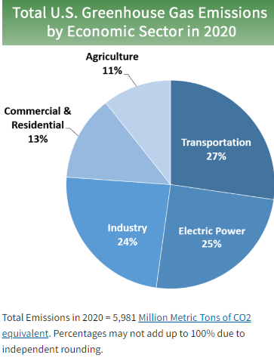
Why Regulate Cars?
1.4 Billion cars worldwide. Many externalities:
GHG emissions
Other air pollutants (e.g., CO, PM, NOx)
Traffic congestion costs
Accidents and fatalities
Noise
Source: EPA (2021).

Slide 5
Some Policy Options
Some options for reducing these externalities:
Fuel Tax: a tax on each unit of fuel purchased.
Emissions Taxes: a tax on tailpipe emissions.
Emissions Standards: Specific required reductions of tailpipe emissions for all car models.
Fuel Economy Standard: A car must meet a certain miles per gallon standard.
Attribute-based Fuel Economy Standard: Different types of cars must meet different miles per gallon standards.
Others: car property tax, tax on car attributes (engine size, age, weight), car type requirements, new/old car registration fee, etc.

Slide 6
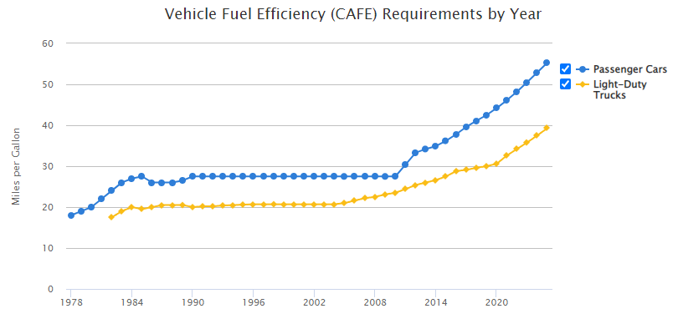
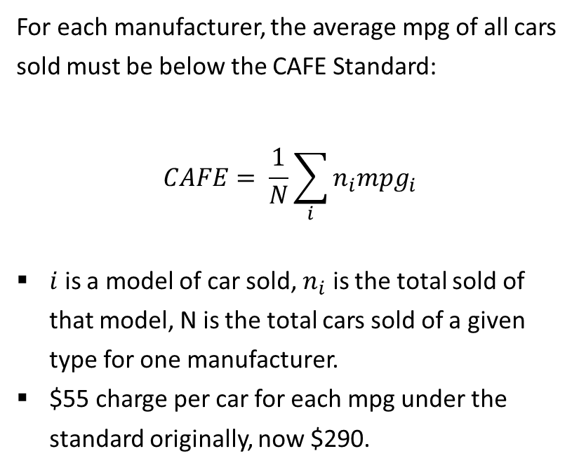
The Corporate Average Fuel Economy Standard
For each manufacturer, the average mpg of all cars sold must be below the CAFE Standard:
$$CAFE= \frac{1}{N}\sum_{i}{n_{i}{mpg}_{i}}$$
$i$ is a model of car sold, $n_{i}$ is the total sold of that model, N is the total cars sold of a given type for one manufacturer.
$55 charge per car for each mpg under the standard originally, now $290.
Source.

Slide 7
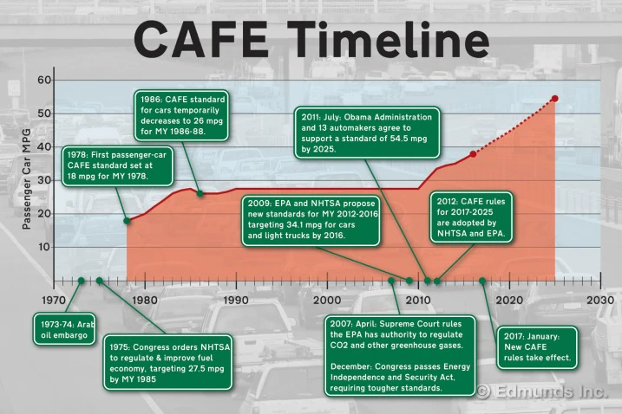

Slide 8
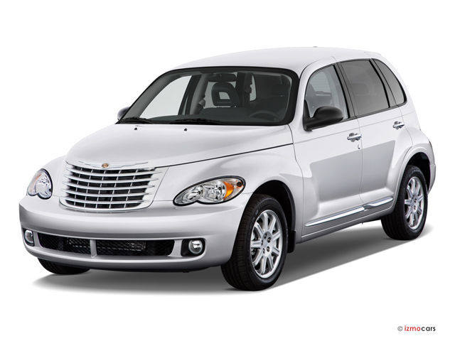
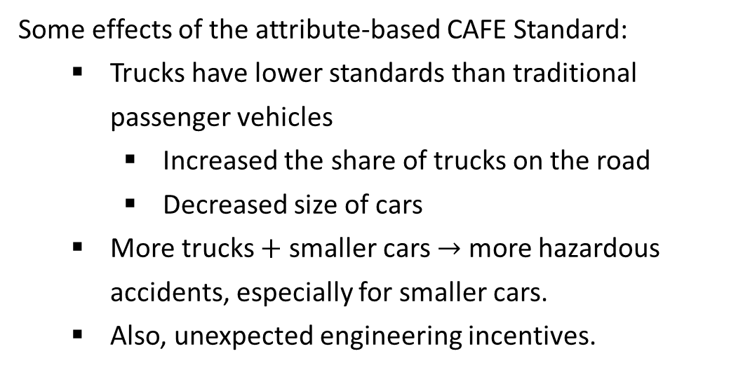
CAFE Standard in Practice
Car or truck?
Some effects of the attribute-based CAFE Standard:
Trucks have lower standards than traditional passenger vehicles
Increased the share of trucks on the road
Decreased size of cars
More trucks $+$ smaller cars $→$ more hazardous accidents, especially for smaller cars.
Also, unexpected engineering incentives.
The PT cruiser was engineered to meet design classifications of a light truck to lower Chrysler’s light truck AFE.

Slide 9
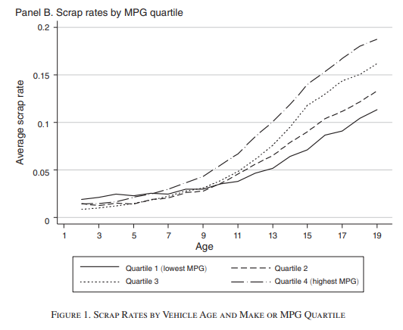
More on CAFE in Practice
Also, the Gruenspecht effect. AFE standards decrease relative sale prices of new high fuel economy cars vs. new low fuel economy cars (Bento et al., 2020).
New high fuel economy cars are relatively cheaper in relation to used ones, hence scrapped sooner
New low-fuel economy cars are relatively more expensive in relation to used ones, hence scrapped later
Source: Jacobsen and Benthem (2015).
Notes:
The reason new high fuel economy cars are relatively cheaper is carmakers distort the prices of low MPG vs. high MPG to ensure they meet CAFÉ standards.

Slide 10
More on CAFE in Practice – The Rebound Effect
A CAFE standard does not directly impact the activity that leads to many externalities associated with driving cars:
No incentive to reduce driving. Actually, incentive to increase driving (the Rebound Effect).
You buy the same car, but it has better fuel efficiency, so you drive more.
More congestion, air pollution, and traffic fatalities.
Carmakers may meet AFE targets with engine changes that can increase emissions of air pollutants other than carbon dioxide.
Shift to gasoline direct injection (GDI) engines increases emissions of particulate matter (Neyestani, 2020).

Slide 11
Why CAFE?
Q: Given these potentially unintended consequences, why implement attribute-based fuel economy standards?
One answer: The primary motivation for AFE standards was energy independence.
Another answer: Consumers systematically mis-judge the vehicle-specific lifetime cost of fuel when purchasing a vehicle because they have MPG illusion.

Slide 12
MPG Illusion
Suppose you drive 10,000 miles per year (about average). Which improvement in
fuel economy is best?
From 10 to 11 mpg
From 17 to 20 mpg
From 35 to 50 mpg
http://www.mpgillusion.com/p/what-is-mpg-illusion.html
Notes:
The answer is (a)

Slide 13
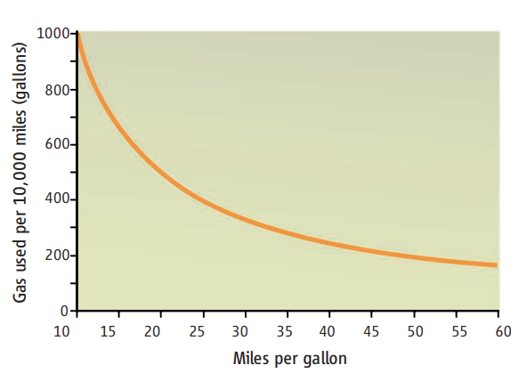

MPG Illusion
$$gpm=\frac{1}{mpg}$$
Miles per gallon is a useful metric for:
How far you can go with one gallon
Range of your tank
What is most useful in making a fuel economy consumer decision?
How much gas you’ll use given your driving habits, or gallons per mile.
Related, how much you’ll spend on gas.
The latter is also more useful for considering the GHG implications. One gallon is 20 pounds of CO2.
http://www.mpgillusion.com/p/what-is-mpg-illusion.html
Notes:
Gas savings are not a linear function of MPG, which is the source of the confusion.

Slide 14
MPG Illusion
Miles Per Gallon | Gallons Per 100 Miles | Gallons Per 10,000 Miles
10.0 | 10 | 1000
11.0 | 9 | 900
12.5 | 8 | 800
14.0 | 7 | 700
16.5 | 6 | 600
20.0 | 5 | 500
25.0 | 4 | 400
33.0 | 3 | 300
50.0 | 2 | 200
Table displays MPG improvements that yield equal decreases in gas consumption
Gas savings are not a linear function of MPG.
Gallons per mile is a more intuitive way of thinking about fuel economy
http://www.mpgillusion.com/p/what-is-mpg-illusion.html

Slide 15
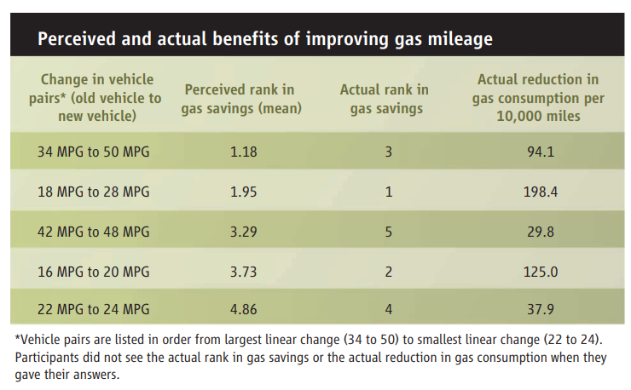
Larrick & Soll, 2008
Consumers do systematically mis-judge fuel economy savings.
Can be improved dramatically by re-framing in terms of GPM and providing this information to consumers.

Slide 16
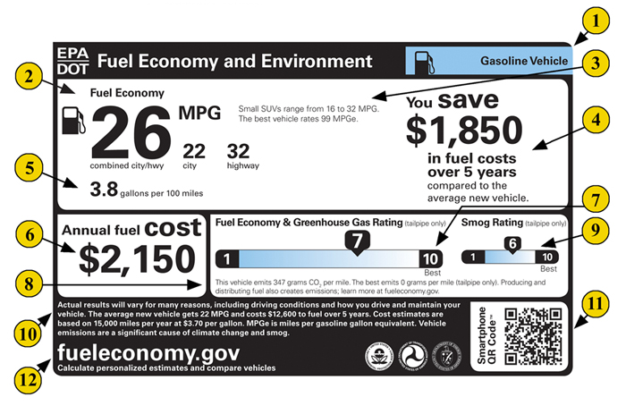
Solving MPG Illusion
http://www.mpgillusion.com/p/what-is-mpg-illusion.html

Slide 17
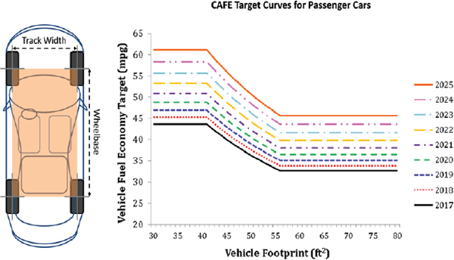
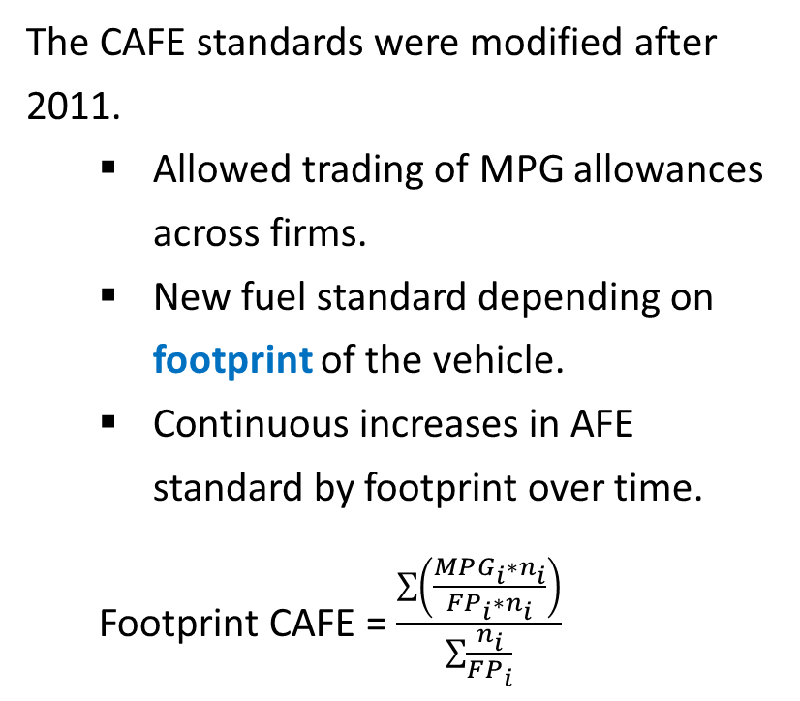
CAFE after 2011
The CAFE standards were modified after 2011.
Allowed trading of MPG allowances across firms.
New fuel standard depending on footprint of the vehicle.
Continuous increases in AFE standard by footprint over time.
Footprint CAFE = $\frac{\sum{\left(\frac{MPG_{i}∗n_{i}}{FP_{i}∗n_{i}}\right)}}{\sum{\frac{n_{i}}{FP_{i}}}}$
Footprint (sq feet)
Source.

Slide 18
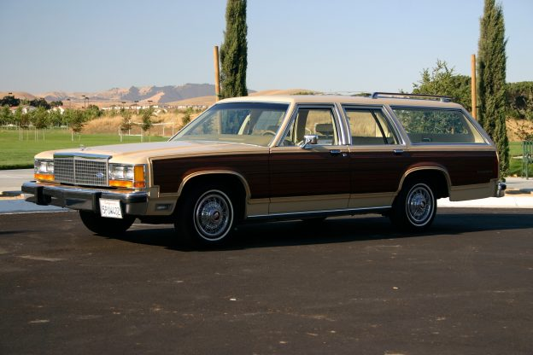
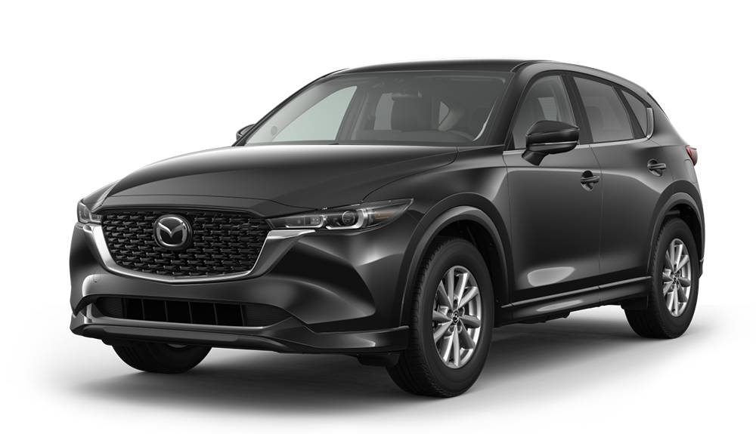
CAFE after 2011: Increased Vehicle Size
One motivation for footprint-based standards was to improve safety. Carmakers no longer had a strong incentive to decrease car size to achieve AFE standards.
Actual effect:
Cars gained larger footprints within type or shifted across types (Jean, 2015).
Compact trucks and station wagons far less common (link).
Aggregate effect on accident fatality risk?
Image source.

Slide 19
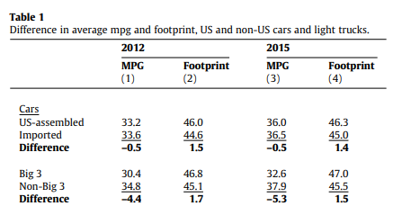
CAFE after 2011: A Tariff?
US-made cars were on average larger and had lower MPG than imported cars.
Imported cars had an easier time meeting a uniform AFE of 33.3 mpg.
Difference in MPG of -0.5 is roughly $28 disadvantage per car for US carmakers.
For big three US auto-makers (GM, Ford, Chrysler), difference of -4.4 is a $242 disadvantage per car.
Source: Levinson (2017)

Slide 20
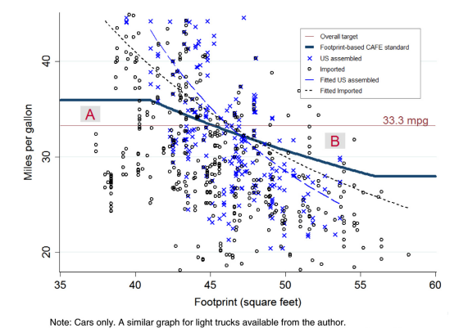
CAFE after 2011: A Tariff?
Fail a new footprint based AFE, but pass a uniform AFE.
Pass a new footprint based AFE, but fail a uniform AFE.
Source: Levinson (2017)

Slide 21
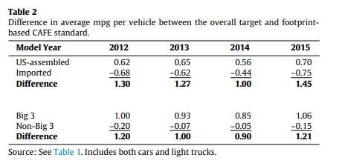
CAFE after 2011: A Tariff?
Switch to footprint-based standards meant US-made cars were on average 0.62 above the new AFE, while imported cars were -0.68 below it.
With fine of $55 per mpg difference, this is a $72 advantage per car.
With trading of allotments, this meant US carmakers could also sell their new footprint advantage to foreign carmakers.
Source: Levinson (2017)

Slide 22
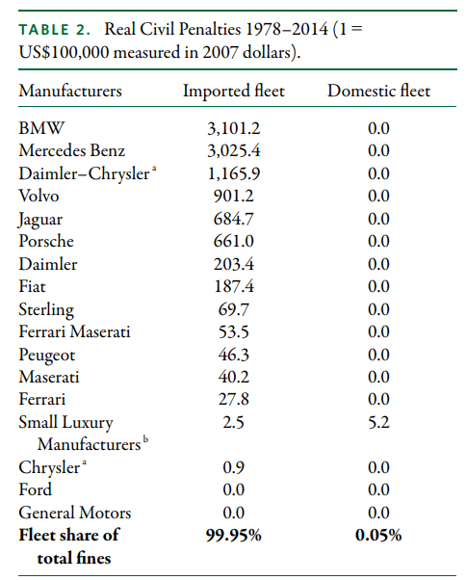
CAFE after 2011: A Tariff?
Source: Levinson (2017)

Slide 23
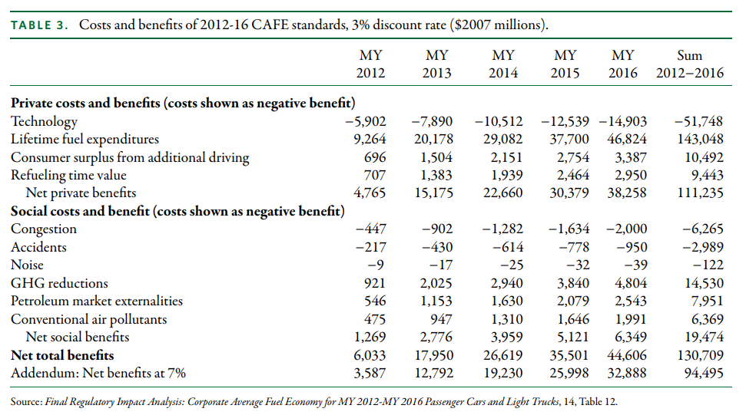
CAFE: Overall Costs and Benefits
Still, large net benefits of new CAFE standards.
What about alternative policy designs?
Source: Levinson (2017)

Slide 24
Fullerton and West (2000)
Research Question: What combination of taxes or subsidies on cars maximizes consumer welfare?
Methods:
Consumer utility model parameterized with real data from 1261 individuals/cars.
Simulate alternative combinations of taxes.
No tax
Ideal Pigouvian tax on externalities
Combination of gas, engine size, and vehicle age taxes.
Calculate welfare improvements.

Slide 25
Fullerton and West (2000)
Results:
1) 71% of the welfare gains from the first-best Pigouvian can be achieved with a three-part tax (gas tax, size tax, vintage tax).

Slide 26
Fullerton and West (2000)
Results:
2) 62% of the welfare gains from the first-best can be achieved with just a fuel tax.

Slide 27
Anderson and Sallee (2016)
To summarize the literature and provide a few key take-aways.
No regulatory alternative achieves the economic efficiency of a fuel tax.
Biases in consumer choice are not strong enough to overturn the finding that a fuel tax is more efficient than a fuel economy standard.
Attribute-based standards are obtuse instruments for addressing behavioral biases because they preserve existing tradeoffs between fuel economy and other car attributes.

Slide 28
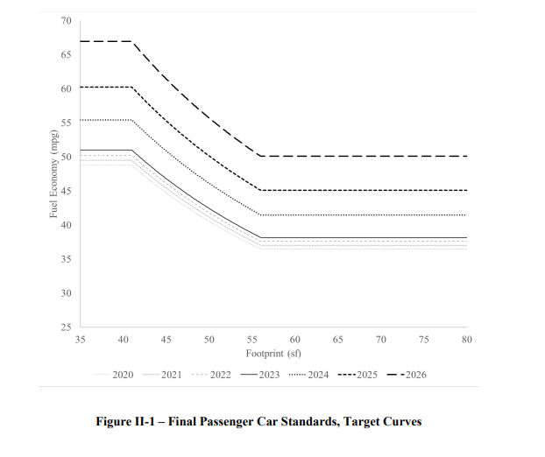
Latest in Average Fuel Economy Standards
New CAFE Footprint-based Standards
Two newer revisions to the rules:
2020 Safer Affordable Fuel-Efficient (SAFE) Vehicles Act
2022 proposed new CAFE sets higher AFE levels over time. Projects 67% of new light cars, 46% of new medium-duty cars, and 15–57% of new trucks being electric by 2032.
Each are the same as 2011 CAFE in policy design. EPA and DOT coordinate on fuel economy and carbon dioxide standards that increase over time.

Slide 29
Part 2: Vehicle Air Pollution Standards

Slide 30
Regulatory Instruments in CAA
The Clean Air Act allows regulation of mobile sources of pollution. Three general types of regulatory instrument have been used:
Technology-based emissions standards for new vehicles
Examples: catalytic converters
Emissions standards for new vehicles
Fuel content regulations
Examples: leaded gasoline, VOCs, renewable fuel standards

Slide 31
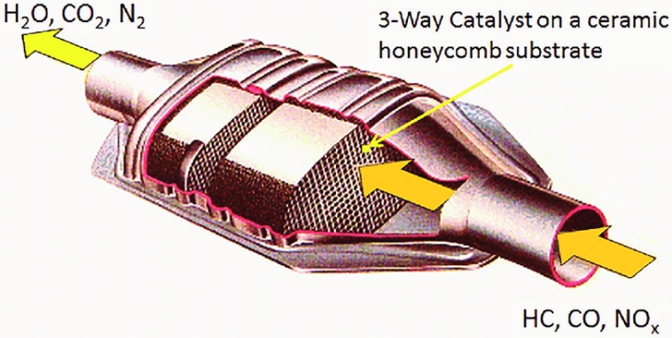
Earliest Emissions Standards
1972 standards for carbon monoxide and NOx in mobile sources essentially required installation of catalytic converters:
Catalytic converters were not economically viable in the 1960s, but rapidly became so after standards.
Composed of precious metals that serve as catalysts in neutralizing air pollutants without altering the metal itself.
Rhodium abates NOx.
Palladium abates CO.
Platinum abates both.
Source.

Slide 32
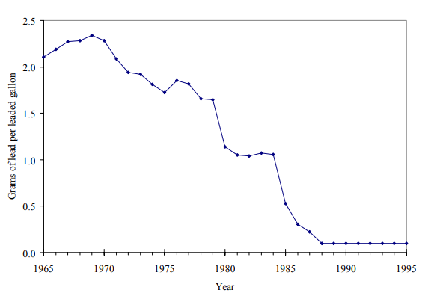
Lead Fuel Content Regulations
Leaded gas fully banned in cars
Market-based phasedown
Lead coats the metals in a CC, decreasing its efficacy over time.
In 1975, new vehicles required to use unleaded gasoline (fuel content regulation)
Smaller refineries couldn’t abate lead from their fuel at competitive costs.
Market-based lead phasedown allowed firms to reduce lead by under the legal limit and sell the difference as credits to other refiners or bank them for later.
Lead phase-down (1982-1987) took place faster than expected and generated 20% savings compared to uniform limit.
Source: Newell and Rogers, 2003

Slide 33
Evolution of Exhaust Standards
Car exhaust standards for specific criteria air pollutants have dramatically lowered these emissions over time.
Few incentives to reduce tailpipe emissions for manufacturers, and consumers are generally not aware of pollution composition of emissions.
Increasing standards over time explains ~99% of the reductions in tailpipe emissions for criteria pollutants (Jacobsen, Sallee, Shapiro, and Benthem, 2022).
Roughly 16 percent of all vehicles sold (80 million), had recalls for failing emissions standards from 1975-2008.

Slide 34
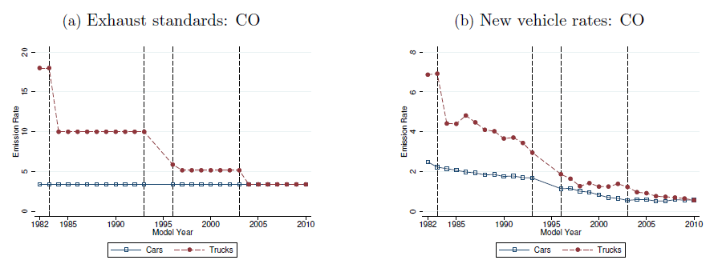
Evolution of Exhaust Standards: CO
Note the y axis is not the same scale across figures
Source: Jacobsen, Sallee, Shapiro, and Benthem (2022).
Notes:
Standards on new cars also assess “in-use” compliance. Manufacturers conduct emissions tests on samples of vehicles at up to 150,000 miles and the EPA audits some. If these tests find emission rates above the standard, the vehicle is recalled and the emissions control system repaired or replaced. This is the reason for the overcompliance.

Slide 35
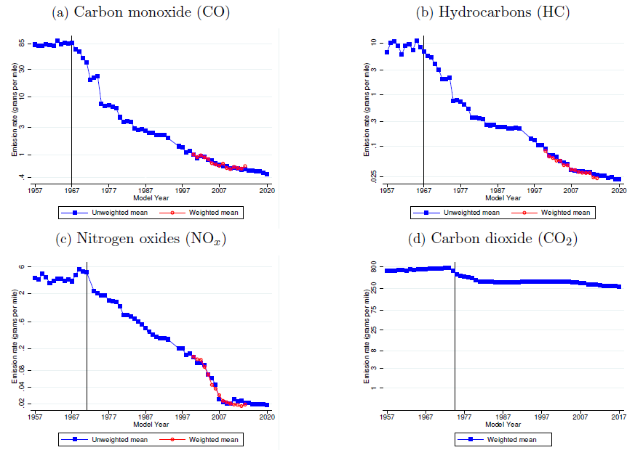
Evolution of Car Emission Rates of New Vehicles
Source: Jacobsen, Sallee, Shapiro, and Benthem (2022).

Slide 36
Pitfalls of Tailpipe Emissions Standards
Two concerns over time:
New car standards increase prices of new cars relative to older cars.
Gruenspecht effect: dirty cars are kept for longer, hence more air pollution.
Cheating on emissions tests: Automakers have incentives to engage in various types of cheating behaviors.
Volkswagen “defeat devices”: Sold 600,000 cars in US from 2006-2015.
Each released equivalent air pollution of 150 gasoline cars.
Estimated 40,000 additional low birthweight newborns caused by the cheating cars (Alexander and Schwandt, 2022)

Slide 37
Part 3: Electric Cars

Slide 38
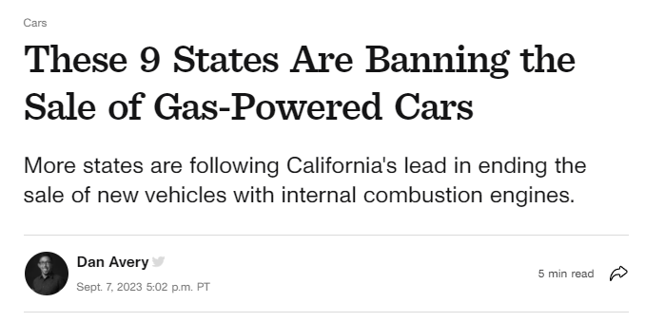
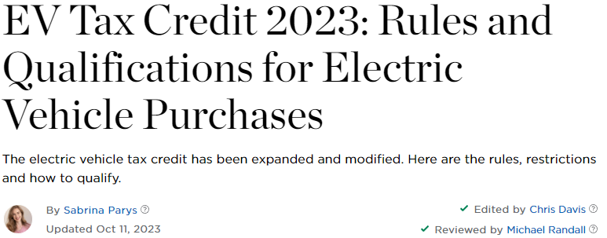
Many New Electric Car Policies
New policies on electric vehicles:
$7.5b for national network of 500,000 EV chargers.
Electric vehicle tax credits ($7500 per car + state credits).
Banning sales of non-EVs after 2035.

Slide 39
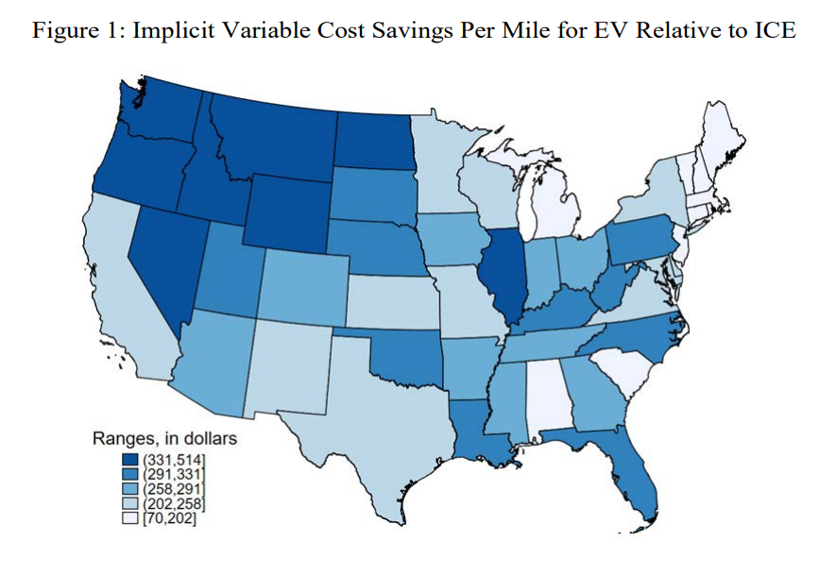
Private Benefits of Electric Vehicles
Benefits of switching to EVs:
Faster acceleration, easier turns.
Lower fuel payments.
No noise.
Lower maintenance
Costs:
Time to charge & charging stations
Range anxiety
Longevity (?)
Comparing fuel savings for the Nissan Leaf and the Nissan Versa Rapson and Muehlegger (2023).
Notes:
ICE = internal combustion engine

Slide 40
External Costs of EVs
Electric vehicles are not without some externalities:
Driving-related externalities discussed earlier (e.g. congestion, accidents) except for noise.
Mining for minerals in batteries
More manufacturing electricity use
Electricity generation from car use (decreasing)

Slide 41
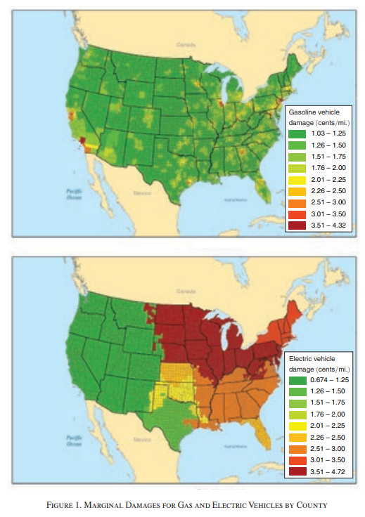
External Costs of EVs
Several studies in the mid 2010s showed that EVs had different GHG and air pollution implications across varying regions of the US (see Holland, Mansur, Muller, Yates 2016), but EVs had become cleaner by 2020 and the gap will only grow (Muller et al., 2020).

Slide 42
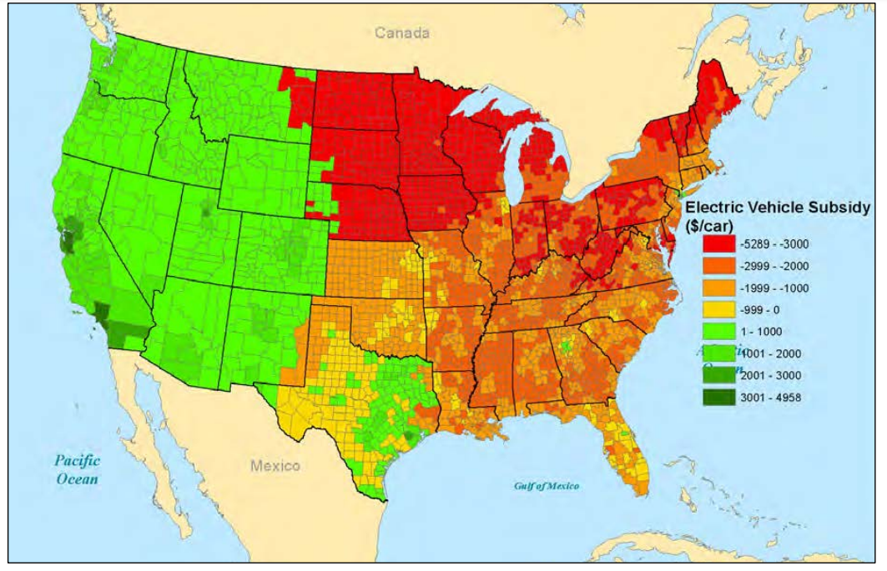

Slide 43
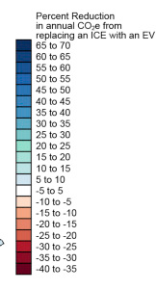
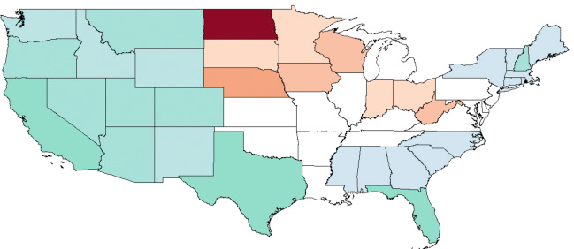
GHGs from EVs
In 2015, EVs also had different GHG implications across varying regions of the US (Archsmith, Kendall, Rapson 2015).

Slide 44
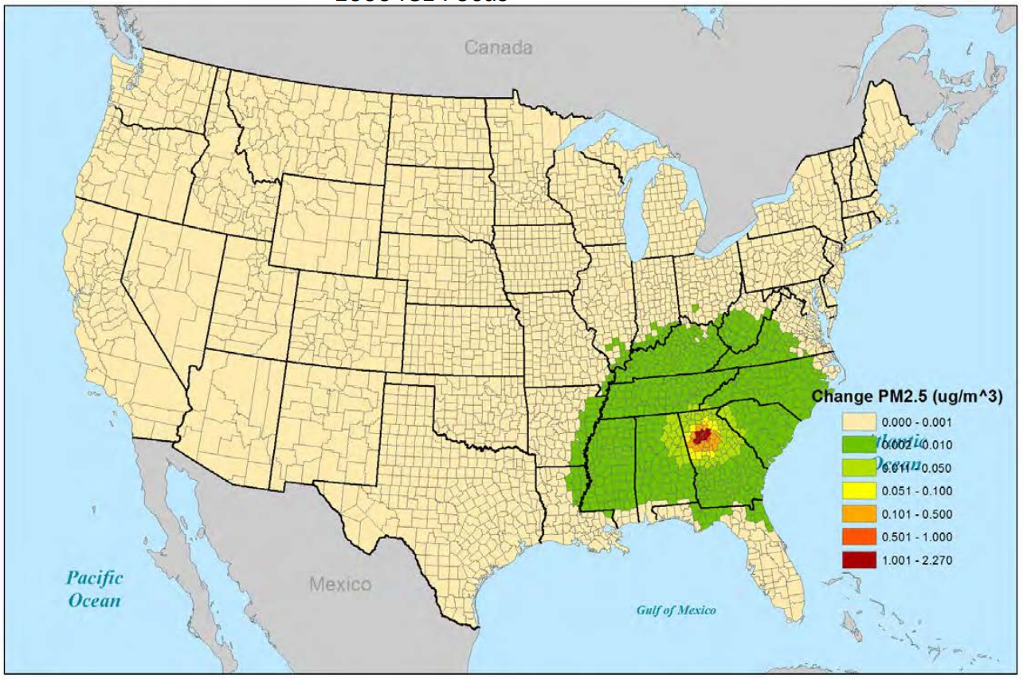
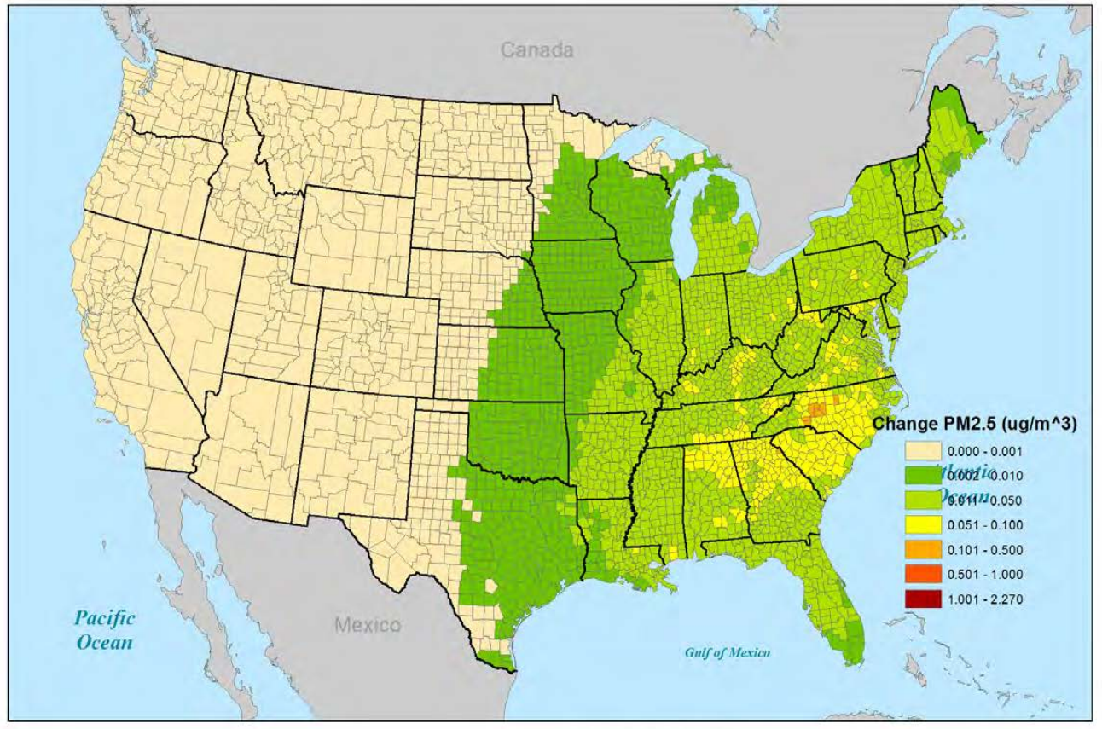
EVs and Equity: Exporting Pollution
PM from ICE in Atlanta
PM from EV in Atlanta
Notes:
ICE = Internal combustion engine

Slide 45
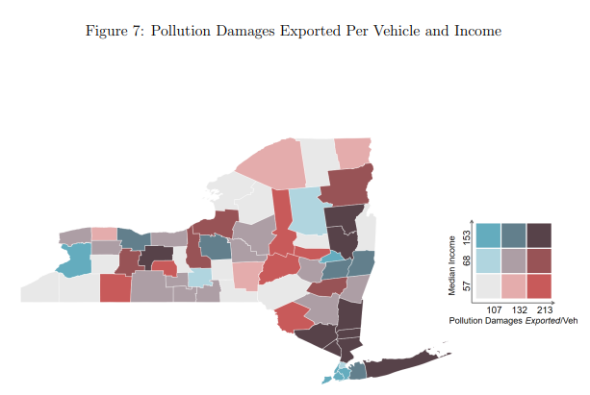
EVs and Equity: Exporting Pollution
Electric vehicles shift pollution from the tailpipe to the power plant.
Suburban drivers tend to have the highest emissions-generated externalities per driver (Nehiba 2023).
CBGs with median income > $65k receive environmental benefits, those below receive negative benefits (Holland et al. 2019).
Notes:
Suburban drivers drive more (more electricity needs) and in general have dirtier generation mixes.

Slide 46
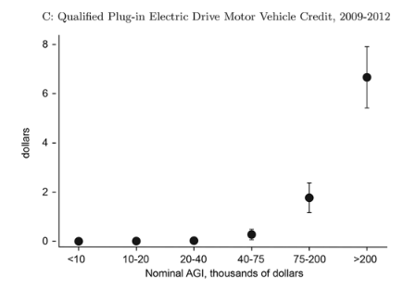
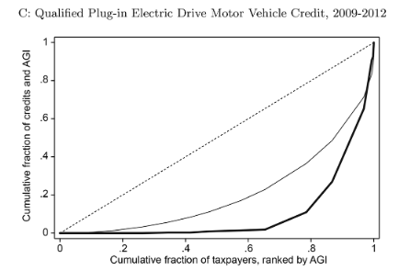

EV Tax Credits and Equity
EV tax credits benefit the wealthiest income quintiles (Borenstein and Davis, 2016). Using tax return data from California:
Top quintile received 90% of all credits for electric vehicles.
How could this be improved?

Slide 47
Next class
Note: your second reflection post is now available.
On Monday we will go over The Clean Water Act. Readings for Monday:
Please read Keiser and Shapiro (2019). It’s a great paper on the topic and it covers a lot of background on the CWA.
(optional) Keiser, Kling, and Shapiro (2018)

